Slide 1
The Black Muslim Experience
Learning Objectives
To understand the experience of Black Muslims in the 70s and 80s
To analyse changes and experiences of Black Muslims in Britain
To compare and contrast the challenges faced by Black Muslims in the UK

Slide 2
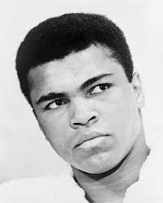
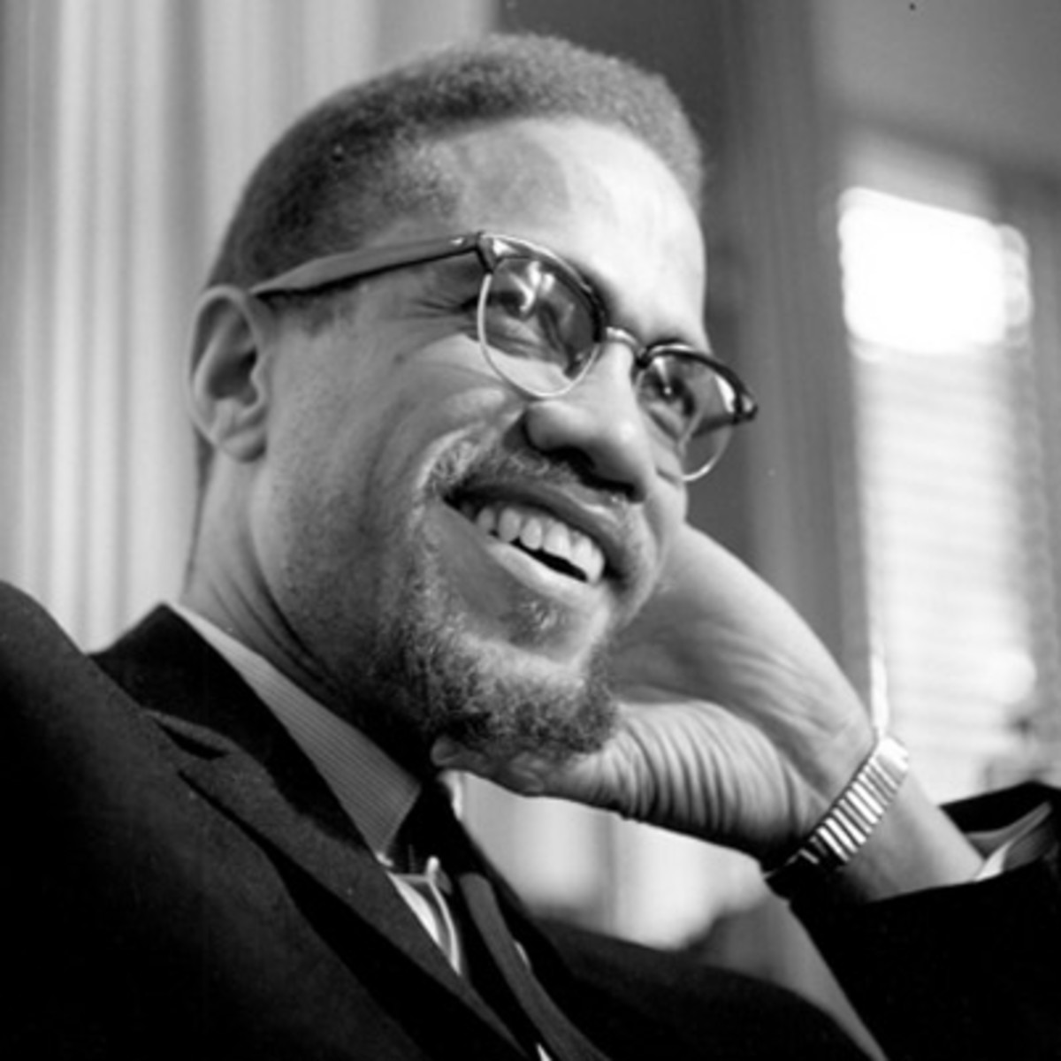
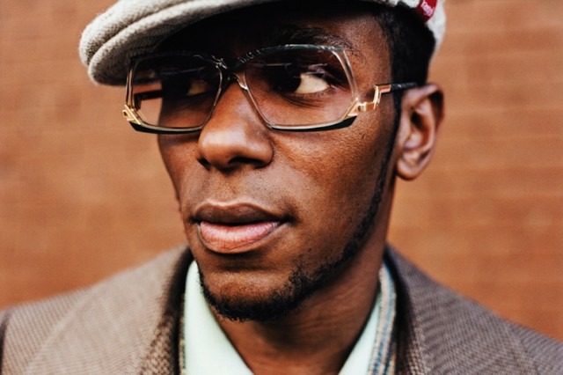
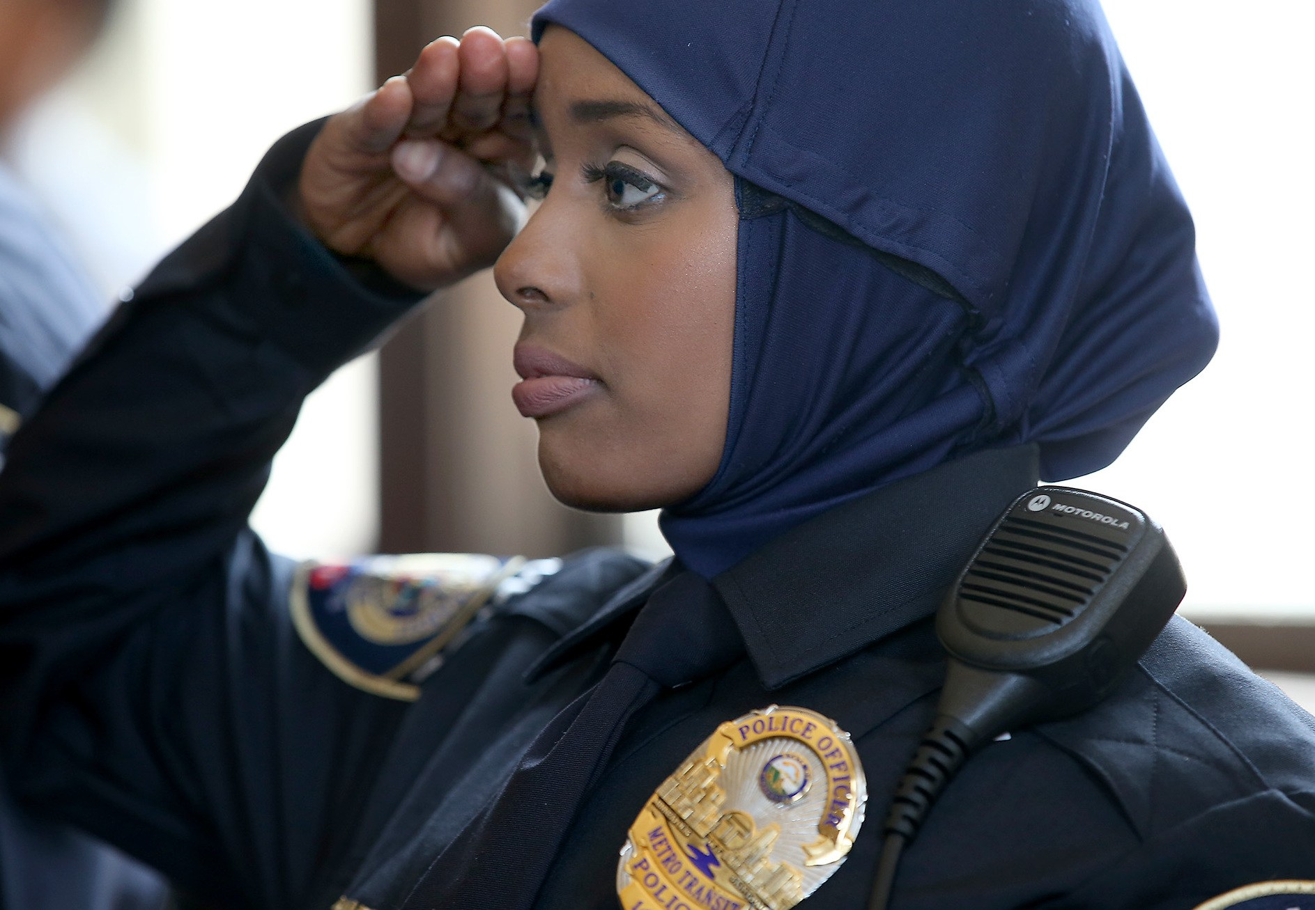
How many Black Muslims can you name?
Malcolm X
Muhammad Ali
Mos Def
Khadra Muhammed
These are all American can you name any British ones?

Slide 3
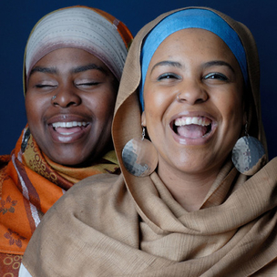
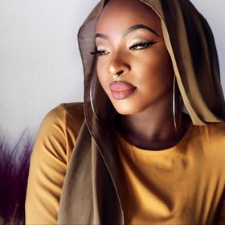
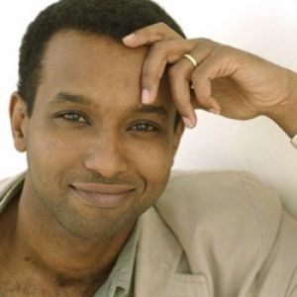
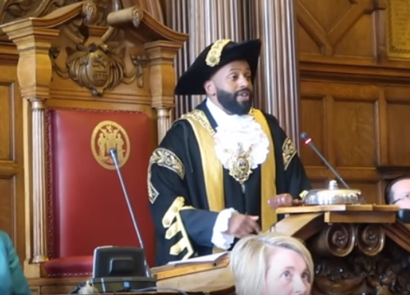
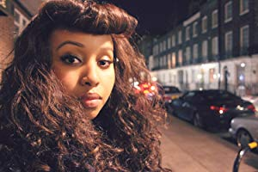
Black British Muslims
Magid Magid
Poetic Pilgrimage
Warsan Shire
Zainab Hassan
Rageh Omaar

Slide 4
Matching Exercise:
Cut up and match the British Muslim celebrities with their jobs

Slide 5
Introduction
There are many diverse communities under the banner of Black Muslim.
In the UK there are significant numbers of West African Muslims for example Nigerians, Ghanaians, Gambians and Senegalese.
Many East Africans Muslims are also living in Britain such as Somalis, Eritreans, Kenyans and Sudanese.
There are also new communities of Black Muslims including people from the Caribbean and Black British people who were born in the UK and who converted to Islam.

Slide 6
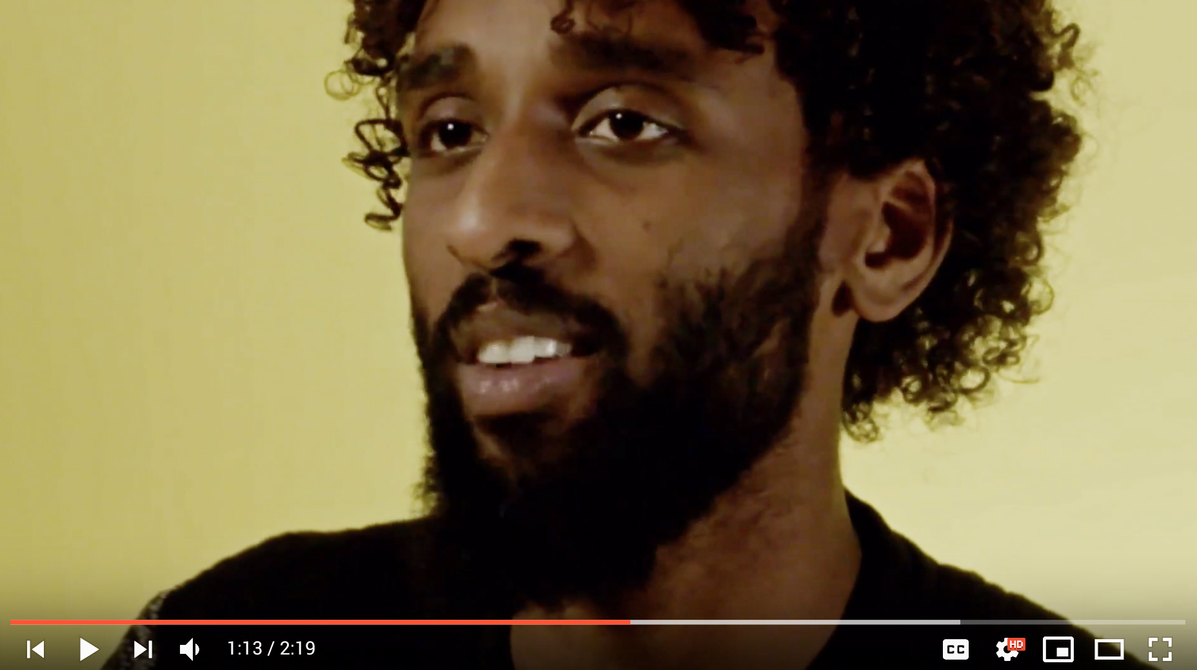
Faisal Salah
Watch this video clip of British-Somali singer and poet Faisal Salah.
Released 2018
Watch here
‘Ancestors hear my call from the place where I call home…’
These are lyrics from the song Faisal was singing in the clip.
1. Who is he referring to when he said ancestors?
2. Write two more lines to add to the song from the clip.
3. List the qualities and attributes that Faisal mentioned in the clip about Somalis in the UK.

Slide 7
Excerpt from the Prophet Muhammed’s (pbuh) last sermon
Read this excerpt from The Prophet Muhammed’s last sermon.
“All mankind is from Adam and Eve, an Arab has no superiority over a non-Arab nor a non-Arab has any superiority over an Arab; also a white has no superiority over black nor does a black have any superiority over a white except by piety and good action. Learn that every Muslim is a brother to every Muslim and that the Muslims constitute one brotherhood. Nothing shall be legitimate to a Muslim which belongs to a fellow Muslim unless it was given freely and willingly. Do not, therefore, do injustice to yourselves”.

Slide 8
Racism
Excerpt from Illuminating the Darkness: Blacks and North
Africans in Islam, Habeeb Akande
“When non-black Muslims refer to the contribution of black people in Islam, they speak about servitude, of lowly figures who rose out of their abject poverty to become 'honourable' Muslims. It's almost a back-handed compliment.” Habeeb Akande- Historian
Task
Explain what Habeeb Akande means by this statement and what does he mean by back-handed compliment?

Slide 9
Amir Kabashi’s racist experience
Source 1.3
Excerpt from an oral history interview with male Amir Kabashi who was born in Sudan in the eighties and came to the UK when he was 8 years old.
“I was on a bus, I was coming back from a night out and there were some Arab boys in the back of the bus and they were like literally ripping the fun out of one of my friends in Arabic – like cause he had like a funky haircut - and I am there, like when you are talking about ultimate dilemma…I thought that was a funny haircut anyway so I was there smiling and then – I noticed like - I don’t know - the conversation start getting racist, do you see what I mean, like it started off like "oh look at him, his hair and blah, blah blah” and then it started getting a bit more racist, like ‘those n***”.

Slide 10
Question time
Read source 1.3
1. What were the boys making fun of?
2. What was the dilemma that Amir had?
3. What would you do in this situation?
4. Has anything like this happened to you?
5. Analyse what happened to Amir and his friend in context to the message from the excerpt from The Prophet Muhammed’s speech. Explain why he would feel hurt by the Arab boys’ behaviour.

Slide 11
Bilal talks about his experience in Islam
Source 1.4
Excerpt taken from an oral history interview with male Bilal Ali Hugh who is 49 and grew up in London and is of Caribbean parentage.
“It’s a mixed experience because it’s the beauty of coming into the religion, it’s the beauty of feeling being part of something that is much bigger than yourself… you know that you share that love for this thing so there was that positive part. But there was also some trials and tribulations, you could say, or discrimination or double standard or maybe just peoples attitude of quote, unquote, heritage Muslims from different parts of the world who you might go to a mosque that’s, that you’re not familiar with, you’re in the area, you just want to pray and you say to the person “Oh Salamu alaikum” and they’re saying “hello” to you which seems a bit impolite and then you say “Akhi” which means brother, you know “is there somewhere I can make wudu [ablution]?” cause you don’t know the place and they saying “Are you Muslim?”

Slide 12
Question time
READ SOURCE 1.4
What name did Bilal give to the Muslims that he felt were being racist?
2. Discuss why he felt offended when the person said “Hello”?
3. Write down an explanation of the reasons Bilal feels converting to Islam has been a ‘mixed experience’.

Slide 13
Read the article ‘Being Black in Islam’
Underline Keywords and phrases in the article
1. What were the main points made in the article?
2. Do you agree with the points made?
3. What are some of the challenges raised in the article for Black Muslims?
4. Do you think challenges faced by Black Muslims will be different for Muslims of other ethnicities? Give reasons for your answer.

Slide 14
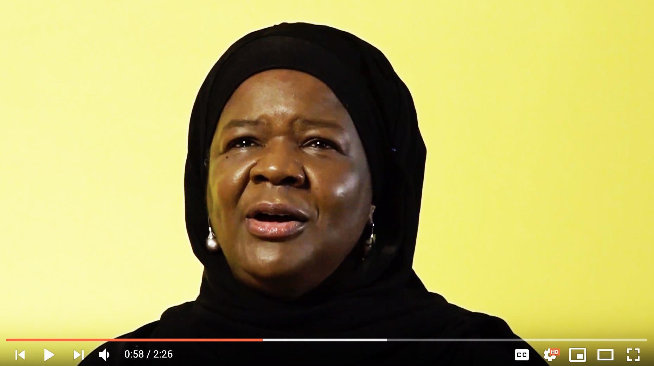
Faizah Salihu
Watch this video clip of Faizah Salihu.
Released 2018
Watch here
1. Faizah reflects on things that make her British. What are they?
2. Why was her experience traumatising?
3. How did Faizah learn about her African heritage?
4. How did Faizah find her way to Islam?
5. Do you think Faizah enjoyed her experience living in London? Explain why?

Slide 15
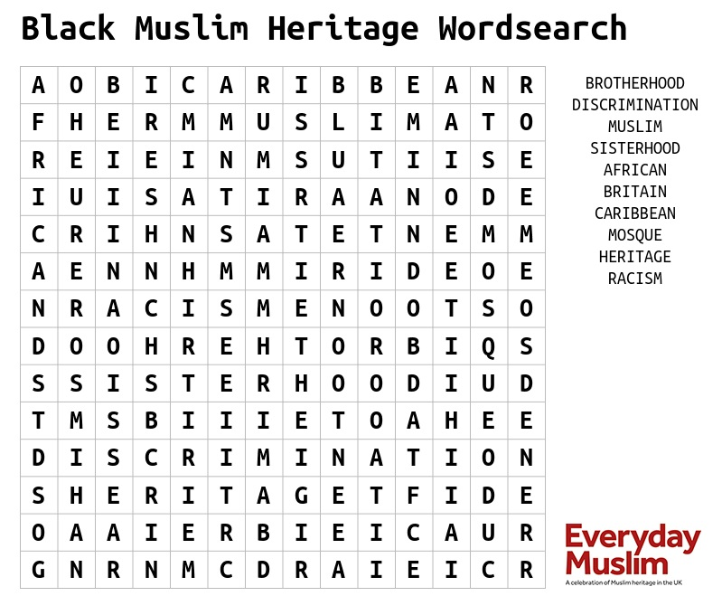
Plenary Complete the word search with the keywords

