Slide 1
Black Muslim Migrants & Refugees
Learning Objectives
To understand some of the reasons why people become migrants or refugees.
To analyse how refugees and migrants are viewed in society today.
To create a poem about being a migrant or refugee.
Key words:
Refugee
Migrants
Migration
Immigrant
Persecution
War
Hijrah

Slide 2
What are some of the reasons that people migrate or become refugees?
Why people become migrants or refugees?

Slide 3
What are some of the reasons that people migrate or become refugees?
To lead a better life for themselves and their family
To find better work or education
Fleeing persecution
Why people become refugees?
Fleeing violence
Fleeing oppression of dictators
Marriage or to join family

Slide 4
Black Muslim Migrants & Refugees
The majority of the black Muslim refugees in the UK come from Africa.
The main countries that they come from are Sudan, Somalia, Nigeria and Eritrea.
The main reason they left their countries is because of war.
In the last 20 years the world has become less stable which leads to more people fleeing their countries.
The reason people flee their countries is to find peace and security and to live a better life.
Some migrants leave their country to find work, better education or to join other members of their family.

Slide 5
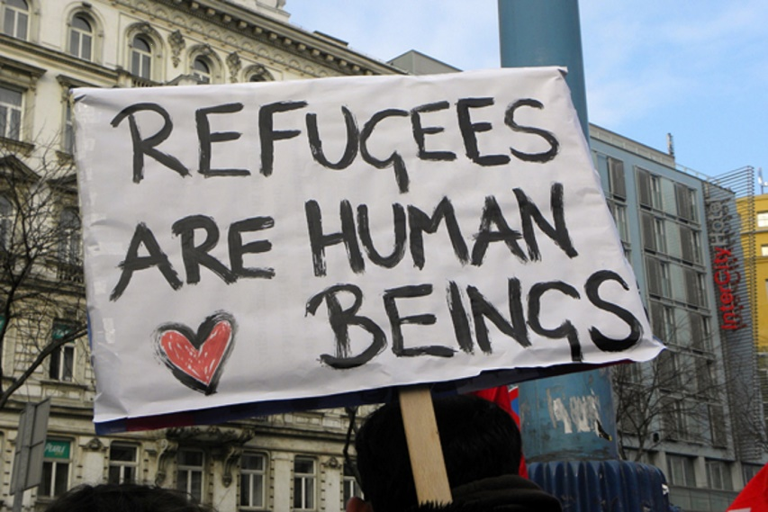
What is a refugee?
A refugee is someone who has been forced to run from their country because of war, violence or persecution.
Refugees are scared of their own country because of their race, religion, nationality or political opinion.
They seek ‘refuge’ in another country where there is no violence/war.
Copy this down

Slide 6
How are refugees seen today?
Look at these newspaper headlines.
What does it tell us about the views of refugees?
Be ready to share your ideas
Think, pair, share with the person next to you.

Slide 7
Being a Refugee
Refugees have to leave their country in pursuit of a better life but they leave behind their homes, friends & family.
Imagine you are being forced to flee the UK; school, friends, family, possessions.
Answer the following questions about how you would feel:
How would you feel if you had to leave your home because of fear of death?
How would you feel about leaving all of your possessions behind?
How easy would it be to fit into a new country where you do not speak the language?
If you had to leave your home in 30 minutes never to return which three items would you take? Explain why?
S&C:
What can be done by the international community to help refugees to make their life easier when they flee their country?
Why do some people hold negative views of refugees?

Slide 8
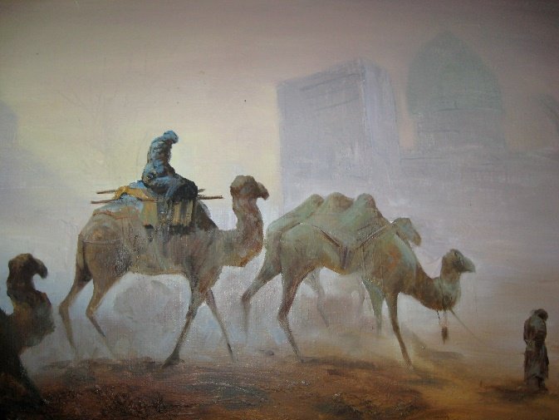
What is the historical link of refugees to Islam?
In the early days of Islam (Over 1,000 years ago):
It was extremely difficult to be a Muslim.
The ruling class of the time were idol-worshippers.
They believed in their idols whole heartedly and were ready to defend them to the death.
Arab rulers of the time persecuted anyone who converted to Islam.
Some of the early Muslims were killed because of their belief.
The Arab tribes of the time came together to try and kill The Prophet Muhammed.

Slide 9
The First Muslim Community
The Prophet Mohammed was informed of the assassination plan to end his life and was advised to leave Mecca and head to Medina.
In Medina, Mohammed already had many followers who were ready to protect and follow him.
The journey he made is known as the Hijrah (migration)
The Muslims had left all of their land and property behind.
They came to Medina the new city with just the clothes on their back.
What are the similarities and differences between refugees now and then?

Slide 10
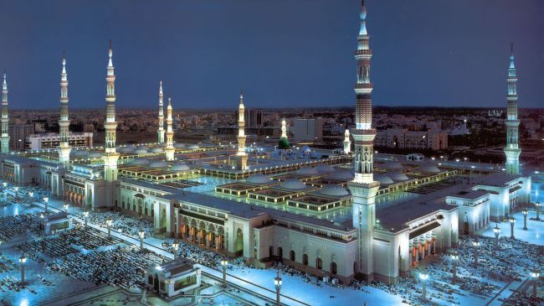
The Muslim Reception in Medina
In Medina the Muslims were met with open arms.
They were given somewhere to live and jobs to do.
They were even offered women to marry.
The Muslims were able to practice their religion freely.
The first mosque was built in Medina
When The Prophet Muhammad entered Medina he was greeted with a heroes welcome.

Slide 11
Food for thought …
Compare the reception the Muslims got when they entered Medina to the reception that refugees are getting today?
Explain why you think this is the case?
S&C: How can we help change the opinions people have of refugees today?

Slide 12
An Interview with Saadat Yusuf
Source 1a
Excerpt from an oral history interview with Saadat Yusuf female born in Nigeria in 1943 and arrived in the UK in 1965
“… my husband was already here. So I just come here to meet my husband.
To study, yes my husband came here. And we ended up staying [laughs]
Well he was here to study law and politics and all those kind of things but at the end of the day we ended up being here because we had children here and so on.”

Slide 13
An Interview with Amir Kabashi
Source 1b
Excerpt from and oral history interview with Amir Kabashi who was born in Sudan in the 1980s and came to the UK when he was 8 years old.
“So my aunty was already over here. She was on a - kind of a diplomatic visa or something. And all I know one day we was in Sudan and then my Mum says, 'how do you lot fancy going to London?' and I was like 'Yay,' [laughs] and then we ended being here and then the next thing you know we're living here”.

Slide 14
Create a poem about being a refugee……
Read source 1a and 1b, Saadat Yusuf’s and Amir Kabashi’s interviews.
Write a poem, a short story or create a short story board about being a refugee or migrant.
Don’t forget to include the reasons why you became a refugee or migrant.
Include your feelings and emotions in your story/poem.
Also include how you were treated by others.

Slide 15
Storyboard

Slide 16
Plenary: Exit Pass
In your books write:
One thing you learned today.
One thing you are struggling with/did not understand.

