Slide 1
Black Muslims in Britain
Learning Objectives
To Identify the different places where Black Muslims originate
To analyse their experience living in the UK
To create a letter based on their experiences in the UK
Keywords
Diversity
Convert
Black Muslim.

Slide 2
Black Muslims in Britain
There are many diverse communities under the banner of ‘Black Muslim’
The United Kingdom is home to significant numbers of West Africans for example Nigerians, Ghanaians, Gambians and Senegalese
You can also find many East Africans living in Britain such as Somalis, Kenyans, Eritreans and Sudanese. All these countries have large populations of people who identify as Muslim
There are also the new communities of Black Muslims including people from The Caribbean and Black British people who were born in the UK, who converted to Islam.

Slide 3
Black Muslim Converts
In the Black Community there are significant numbers who have converted to Islam
Many of the people convert from Christianity
Some are on a search for spirituality and come across Islam
Others have said they converted to Islam because they feel it has the political structure for self advancement.

Slide 4
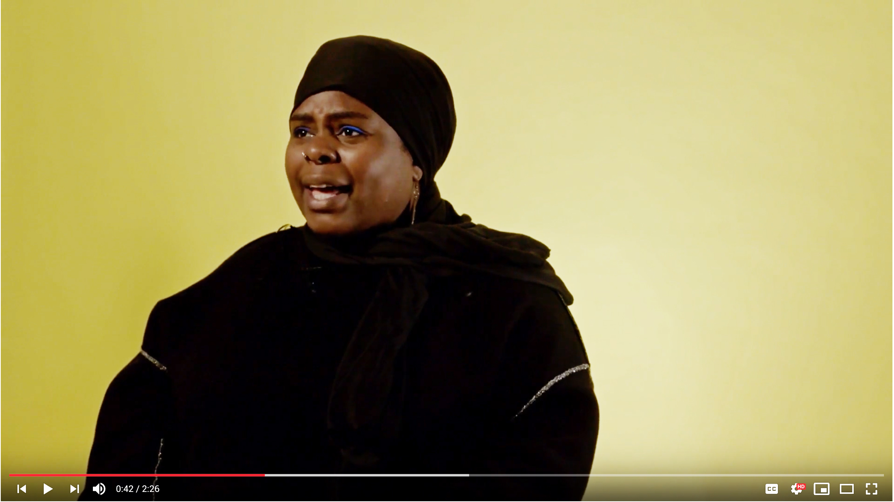
Tanya Muneera Williams
Click here to watch: Tanya Muneera Williams
Release 2018 Duration 2 minutes 25
What did Tanya do after she discovered that in her opinion she didn’t ‘fit in’?
Discuss what Tanya meant when she said ‘I am a universe.’
Do you agree and disagree with Tanya that all people are universes. Explain why?

Slide 5
Bilal Ali Hugh conversion to Islam
Source 3a
Excerpt from an oral history interview conducted with Bilal Ali Hugh, male 49 years old.
“And then I came upon Malcolm X’s literature and read his life story and that was like the lights went on. Something happened and it became like wow. Islam, black consciousness, you know it was kind of synonymous in my mind at that time. But yeah Malcolm X was , I have to say, a key, pivotal person.”

Slide 6
Discuss and write down 5 reasons why people may convert to Islam
1. Identity
2
3
4
5

Slide 7
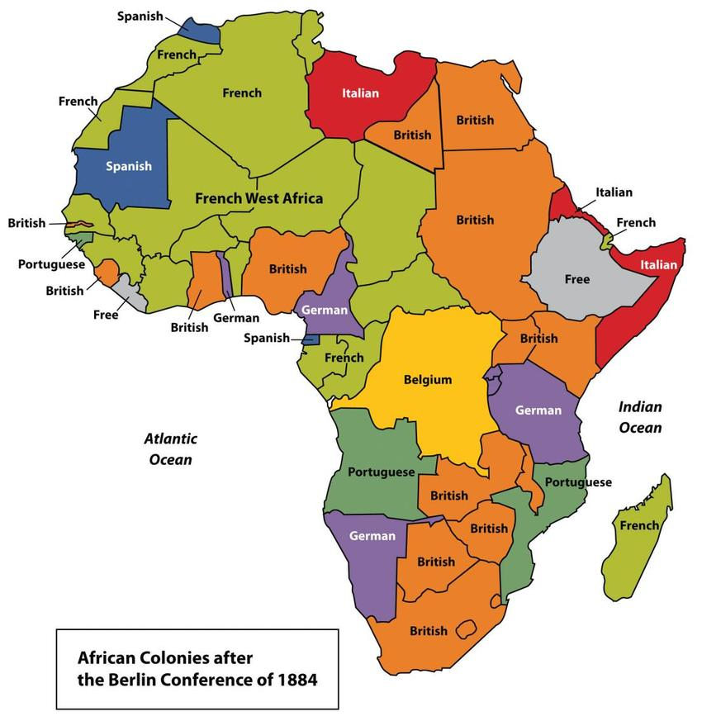
Islam in Africa
The continent of Africa is home to a high population of Muslims
Majority Muslim countries are in the north e.g. Egypt, Sudan, Algeria and Morocco
Countries in West Africa with large Muslim populations are: Gambia, Mauritania, Mali, Nigeria and Senegal
Muslims can be found living in most African countries
In South Africa Islam is the fastest growing religion.

Slide 8
Islam in the Caribbean
Muslims can be found in many countries in the Caribbean.
These countries include Jamaica, Guyana, Trinidad and Dominica.
The first significant wave of Caribbean Muslims in the UK dates back to the 1950’s.
It started with individuals converting to Islam.
Most of them were Christians before that.
One of the main reasons blacks were converting to Islam is because they saw justice and equality in the new religion.

Slide 9
Old Kent Road Mosque
SOURCE 3b
Muslim Association of Nigeria on Old Kent Road is one of the first black owned mosques in the UK and is found in South London.

Slide 10
Muslim Association of Nigeria
The Old Kent Road Mosque is officially known as The Muslim Association of Nigeria (MAN). It was established in the UK in February 1961 as a branch of MAN in Nigeria by a group of Nigerian students.
The focus of the founding fathers was to encourage brotherly relations and Islamic social interaction among Muslim students of Nigeria most of whom were of the Yoruba people from South-Western and North-Central Nigeria. They were concerned to identify themselves as Muslims, while at the same time pursuing western education.

Slide 11
Questions?
Where are most of the people from who go to Old Kent Road Mosque (MAN)?
Who started the mosque?
When did the mosque first open?
Look at source 3b. Describe the scene in the picture of MAN.
Discuss and write down an explanation why it was important for the Nigerian students to form the MAN organisation.

Slide 12
Saadat’s first impression of the UK
Source 3c
Excerpt from an oral history interview conducted with Saadat Yusuf, female born 1943 who arrived in England from Nigeria in 1965
…when you come here what you see there is not the same. Because they talk about the weather and when you actually come here its nothing like what you hear and the houses is like this as well. Another thing I notice is the doors are lock, shut. You know, back home we don’t have that at all. Because people have to come and ring the bell like you did today.

Slide 13
Question time
Read source 3c
1. What was Saadat’s first impression of the UK?
2. Why was she shocked about the door being locked?
3. Explain why didn’t she have a correct impression of the UK?

Slide 14
Taiwo Ali’s first impression of England
SOURCE 3d
Excerpt from an oral history interview conducted with Taiwo Ali (female) born in 1962 who came to the UK when she was 44 years old from Nigeria.
“I think I would say some people are accommodating, while some people can be so hostile to you especially when... in the workplace. They spoke to me, then I used to feel so upset, so sad... I felt like going back to Nigeria.”

Slide 15
Amir Kabashi’s first impression of England
SOURCE 3e
Excerpt from an oral history interview conduced with Amir Kabashi male (born in the 1980s) who came to England from Sudan when he was 8 years old.
“…ummm creepy, I generally felt it was creepy, like, people were expressionless, do you know what I mean, so try to imagine an eight year old and you're looking up to all of these Russian people, whereas, where I just come from, people walk really slowly, do you know what I mean.

Slide 16
Add the first impressions to the spidergram.
Black Migrants first impressions

Slide 17
Interaction with the locals
SOURCE 3f
Excerpt taken from an oral history interview with Saadat Yusuf female born 1943 in Nigeria and arrived in England in 1965.
I make friends with my next door neighbour opposite. She’s a Irish lady but her husband is Nigerian, yeah so she’s the one who actually take me on. And I still I mean she passed away now, but her children I still see one or two of them. Yes, she’s the best lady I ever met.
She’s the one that helped me to go round and go to the shops and you know go and learn English more. Because we speak English in Nigeria but its not the same when you come here, it not the same.
She introduced me to GP, and so on. She’s a very nice lady, very nice lady.

Slide 18
Saadat Yusuf discrimination
SOURCE 3g
Excerpt of an oral history interview conducted with female Saadat Yusuf born 1943 who arrived in England in 1965.
“The only thing I notice is the shops some of the shops they don’t want black people to go in there and so on and you see on the notice board you know people put a notice to rent a room and then there goes ‘no black, no Irish, no dog’. You know I seen that with my own eyes. But otherwise nothing directly at me as an individual.”

Slide 19
Task: Create a letter
Read sources 3f and 3g
Imagine you have just arrived in England write a letter to a parent or family member who lives back in Africa or the Caribbean.
In the letter you should add details about what you have seen in the UK. Try to include positive and negative descriptions in your letter.
Also add how you felt about living in the new country and your interactions with the locals.

Slide 20
The Muslim Sister’s Jamaat on a trip to Dublin
SOURCE 4a – Photograph taken by Muslim Sister’s Jamaat.

Slide 21
The Need for Community
SOURCE 4b
Excerpt of an oral history interview conducted with female Saadat Yusuf born 1943 who arrived in England in 1965.
“Because as you say the Muslim women has no other places to go and to meet other people we started this Muslim Sister’s Jamaat I think its in 1986 or ’85. I wasn’t around with them at the time but it was a few sisters who actually embraced Islam at that time they wasn’t a Muslim, they embraced Islam they the ones started Muslim Sister’s Jamaat…But for the last twenty years I actually run it and I’m the coordinator, you know of the organisation.”

Slide 22
A Space for Sisters: The Aim of the Muslim Sister’s Jamaat
SOURCE 4c
Excerpt of an oral history interview conducted with female Saadat Yusuf born 1943 who arrived in England in 1965
“The role is actually to create a space for sisters. You know that its sisters only with young children they can come. The first time we used we started sisters house like in here and we had teas and coffee and whatever. And the women just chat and so on. And then we improve in Ramadan we do like the last ten days in different sisters house. We actually sleep in sisters house. And in here, you know, we sometimes do the last three days here and so on. So and we improved that we do classes.

Slide 23
SOURCE 4d
Excerpt of an oral history interview conducted with female Saadat Yusuf born 1943 who arrived in England in 1965
“Yeah, it’s a support group. Yes that’s why we say Muslim sisters, its not Nigerian, or African or Asian or whatever…sisters. Whatever you come from as long as you’re Muslim. However, even now we have the non-Muslim come. Why? Because some of the sisters they embrace Islam and they have their cousins or whatever are not Muslim so they say “Oh come you know to the group” and they come.“

Slide 24
Task
Look at source 4a think about a time you went on a trip with family and friends outside your city or town. Write down where you went and how you felt?
Discuss and then write down the reasons you think the Muslim Sister’s Jamaat was formed. What are the benefits of the group and who is it for?

