Slide 1
Shades of Muslim
Racialisation, representation and White British Muslims
Amena Amer
PhD student, Institute of Social Psychology
London School of Economics and Political Science
Email: a.amer@lse.ac.uk

Slide 2
In context
In popular and political discourse, British Muslims are rarely discussed in terms of their ethnically diverse make up.
South Asians – largest ethnic group which make up the British Muslim community.
Need to acknowledge diversity.
White Muslims provide an interesting challenge to our perceptions of British Muslims as a group.

Slide 3
Presentation outline
A brief history of White Muslim converts in Britain and some attempts to establish a British conception and practice of Islam.
Explore and identify the problems that arise through the racialisation of the category British Muslim as principally non-White.
Raise important points about the consequences of racialisation and exclusion of different groups, including White converts, from everyday thinking of “British Muslims”, particularly in relation to our understanding of Muslim heritage.

Slide 4
White British converts in the UK
7.8% of those who identify as Muslim, also identify as “White” (UK Census, 2011).
2.9% identify themselves as “White British” (ibid).
Number of converts in Britain in 2010 is approximately 100,000 (Faith Matters, 2011).

Slide 5
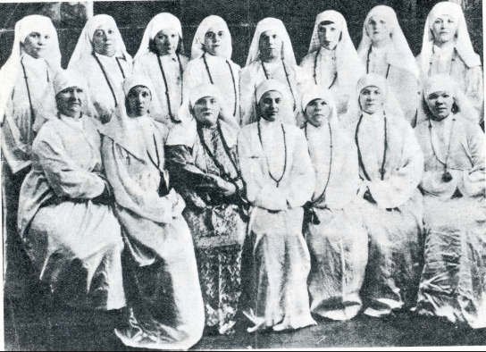
History of White Muslim converts
Wives of Lascars
(sailors from Indian subcontinent)
Wives of Yemeni dock workers and sailors
Halliday, F. (1992). Britain’s First Muslims: Portrait of an Arab Community
1930’s, South Shields. Wives of Yemeni sailors receiving instruction in Islam.

Slide 6
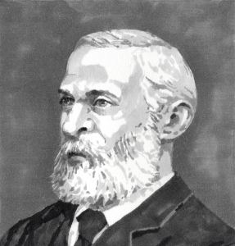
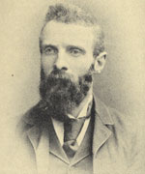
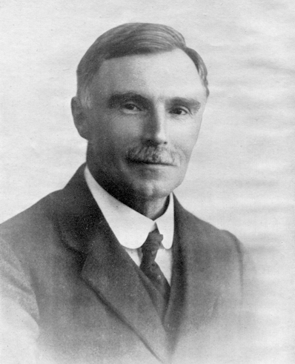
https://jamiegilham.wordpress.com
http://en.wikipedia.org
http://wokingmuslim.org
Henry Stanley (1827-1903)
First Muslim Briton to live and die on British soil.
Abdullah Quilliam (1856-1932)
Founder of England’s first mosque and Islamic centre.
Marmaduke Pickthall (1875-1936)
The first Muslim to translate the Qur’an into English.

Slide 7
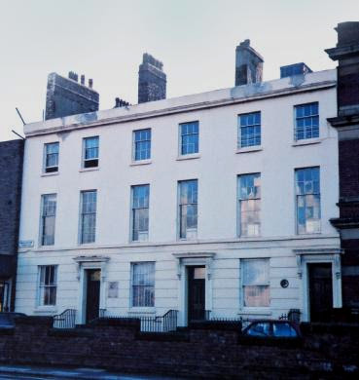
England’s first mosque
Liverpool Muslim Institute
Founded by Abdullah Quilliam in 1887.
First Muslim missionary organisation in Britain, establishing the first “community”.
Its mission was in-keeping with vision of founder who was the first to propagate Islam in Britain and actively seek and encourage conversion among other White Britons.
http://melbourneblogger.blogspot.co.uk/2011/01/william-abdullah-quilliam-islam-and.html
Liverpool Muslim Institute, 8 Brougham Terrace.

Slide 8
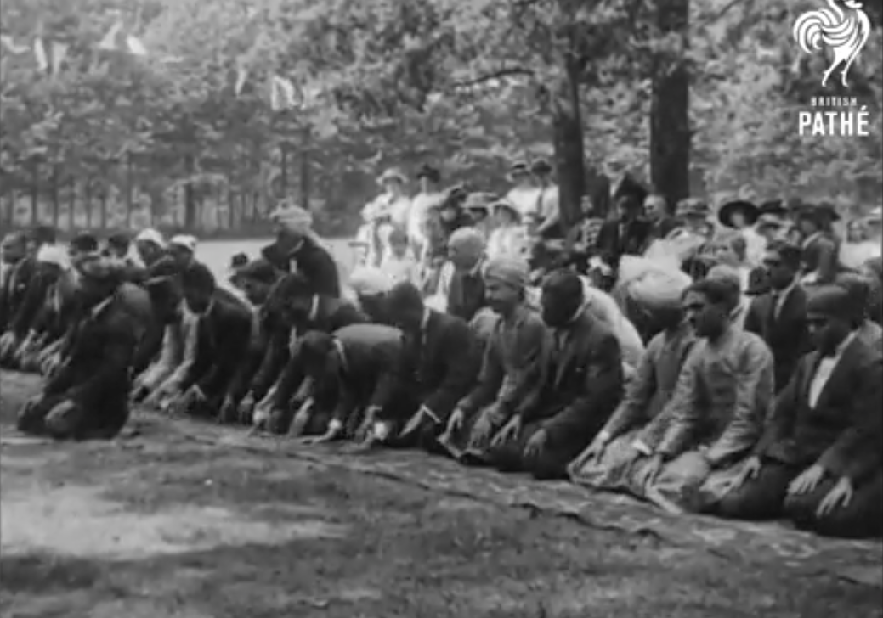
Eid prayers at Woking in Surrey. (Filmed between 1910-1919). British Pathé.
Link: https://www.youtube.com/watch?v=0i_H3Xf9Ly0

Slide 9
Racialisation of Muslims
Dominant association with Muslims and Islam was the Ottoman Empire.
Being English or British embedded in Christian values and practice and ideas of Whiteness (Franks, 2000).
White Muslim converts seen as traitors.
Displaying the behaviours of a “Turk”
“Islam was a religion made for men by a man, and for coloured men only”. Griffiths recalling committee members reaction to conversion in 1933. (quoted in Gilham, 2014).

Slide 10
Notion of being Muslim principally foreign, and cannot be placed alongside a White British identity.
“Pakistanised” (Köse, 1996).
“Not quite White enough” or “not White” at all (Moosavi, 2014).
Mirrors the narrative around Muslims in the media – “outsiders”, “foreign” religion, far removed from what is institutionalised as British.

Slide 11
Visual markers and racialisation
Racialisation more likely to occur where visual markers of “Muslim-ness” are present, e.g. hijab.
Visual markers of religion are powerful, particularly in the case of White converts where they can challenge representations of who Muslims are and what they look like.
White Female Muslim converts who wear the hijab more likely to experience anti-Muslim attacks (Franks, 2000).

Slide 12
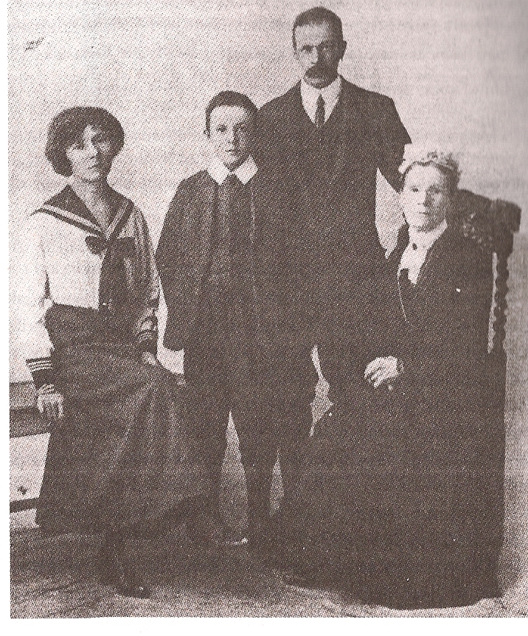
Moving forward
Must not fall into the same trap.
British Muslim heritage isn’t something that was brought over from abroad necessarily, there is also a “home-grown” heritage.
“…My family and I break our fast with leek and potato soup… for Eid, we have roast dinner” (Interview, F3).
Is there a space for the diversity of Islam in Britain when archiving and recording Muslim heritage in Britain?
Gilham, J. (2014). Loyal Enemies: British Converts to Islam, 1850 – 1950.
The Welchs, 1916. A British Muslim family

Slide 13
References
Brice, K. (2011). A Minority Within a Minority: A Report on Converts to Islam in the United Kingdom. Faith Matters.
Franks, M. (2000). Crossing the borders of whiteness? White Muslim women who wear the hijab in Britain today, Ethnic and Race Studies, 23 (5), 917-929.
Gilham, J. (2014). Loyal Enemies: British Converts to Islam, 1850 – 1950. London: Hurst.
Halliday, F. (1992). Britain’s First Muslims: Portrait of an Arab Community. London: I. B. Tauris.
Kose, A. (1996). Conversion to Islam: A Study of Native British Converts. London: Kegan Paul International.
Moosavi, L. (2014). The racialization of Muslim converts in Britain and their experiences of Islamophobia. Critical Sociology.

